Slide 1
Lab 2: Automatic Speech Recognition
Ying shen and deng hao
School of software engineering
tongji university

Slide 2
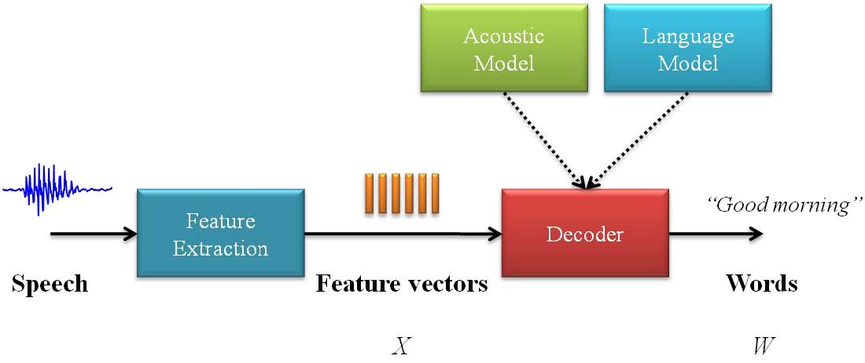
Architecture of an ASR system

Slide 3
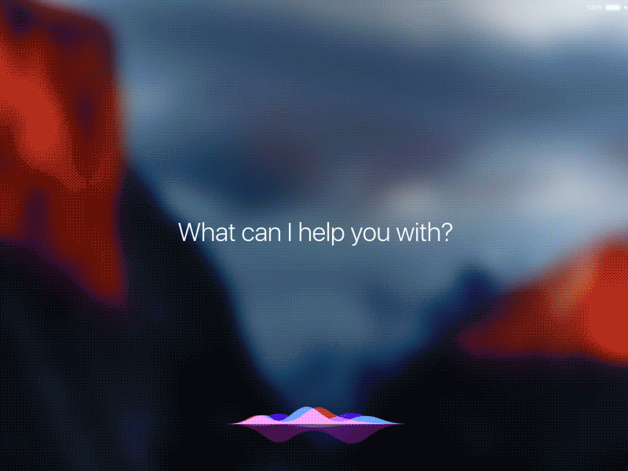
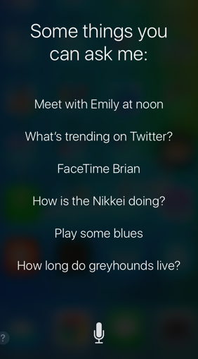
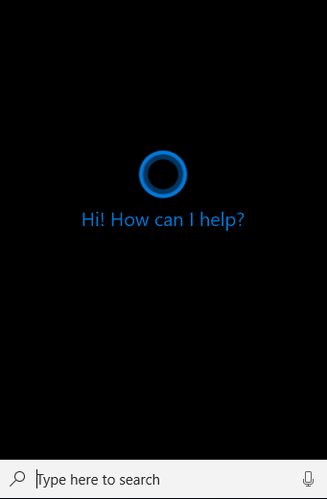
Voice UI
Notes:
现在语音交互VUI触发的常见类型有：
（1）语音触发：例如iphone配置的siri
（2）触觉触发：按下按钮或者切换空间
（3）动作触发：在传感器前完成某种手势动作
（4）设备自己触发：事先预定好的设置触发设备

Slide 4
Introduction to Python and Pypi
A handful of packages for speech recognition exist on PyPI
apiai
assemblyai
google-cloud-speech
pocketsphinx
SpeechRecognition
watson-developer-cloud
Official site of SpeechRecognition: https://pypi.org/project/SpeechRecognition/

Slide 5

Install Python(Anaconda)
Official site of Anaconda: https://www.anaconda.com/
Install Tutorial: https://zhuanlan.zhihu.com/p/123188004

Slide 6
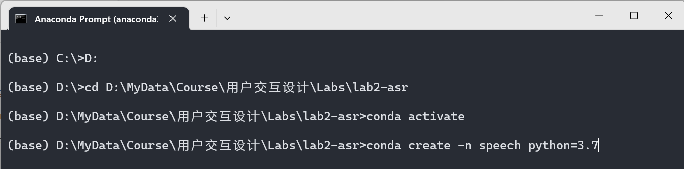
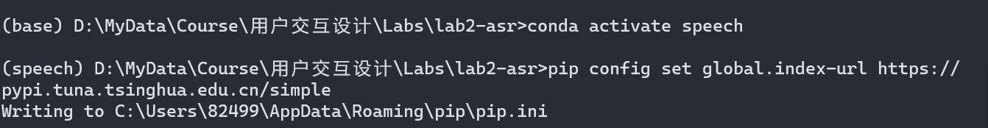
Create Environment(Windows)
打开 Anaconda Prompt
切换到项目目录下(以D盘为例)：
切换盘符：D:
切换目录：cd 目录名称
创建ananconda环境：
激活conda：conda activate
创建python3.7虚拟环境：conda create -n speech python=3.7
激活虚拟环境： conda activate speech
pip配置清华镜像源：
pip config set global.index-url https://pypi.tuna.tsinghua.edu.cn/simple

Slide 7
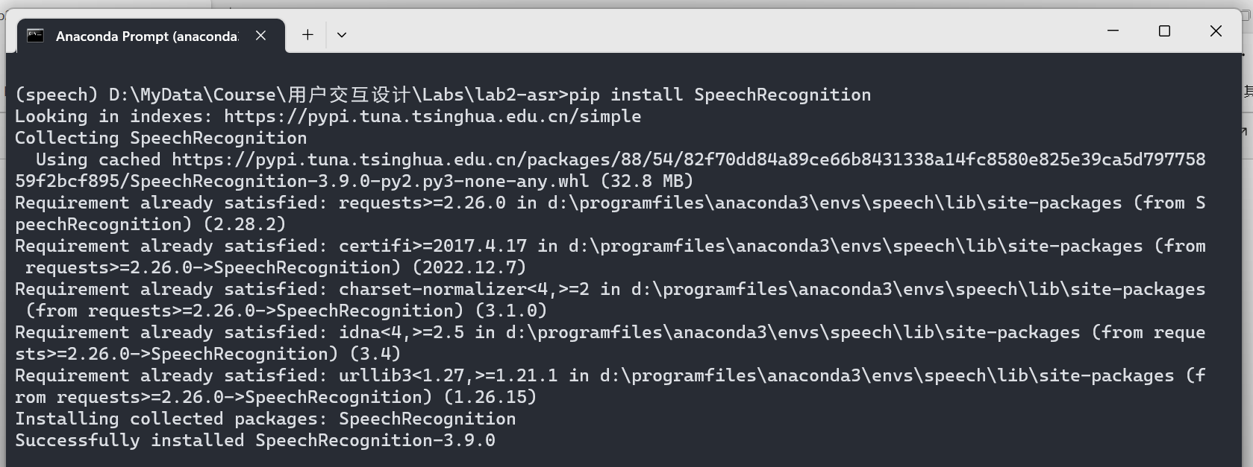
Install SpeechRecognition (Windows)
安装SpeechRecognition：pip install SpeechRecognition

Slide 8
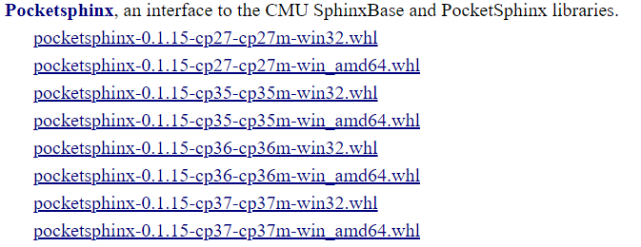
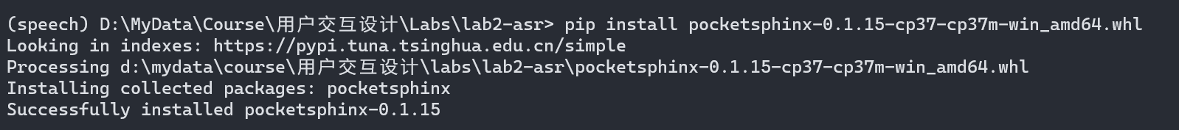
Install PocketSphinx (Windows)
下载二进制包：https://www.lfd.uci.edu/~gohlke/pythonlibs/#pocketsphinx
以windows python3.7版本为例：https://download.lfd.uci.edu/pythonlibs/archived/cp37/pocketsphinx-0.1.15-cp37-cp37m-win_amd64.whl
将whl文件放在项目目录下
安装二进制包：pip install pocketsphinx-0.1.15-cp37-cp37m-win_amd64.whl

Slide 9
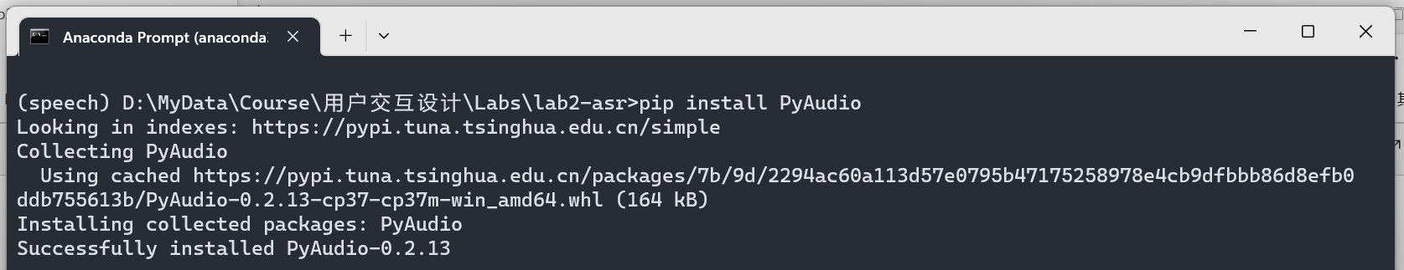
Install PyAudio (Windows)
安装PyAudio：pip install PyAudio

Slide 10
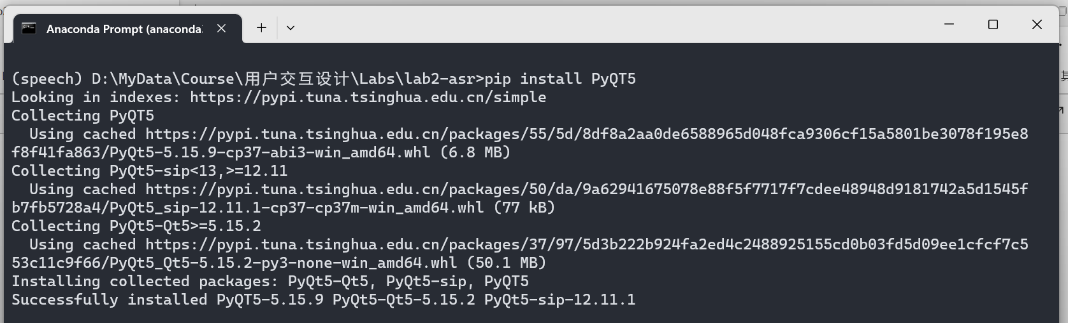
Install PyQT5 (Windows)
安装PyQT5：pip install PyQT5

Slide 11
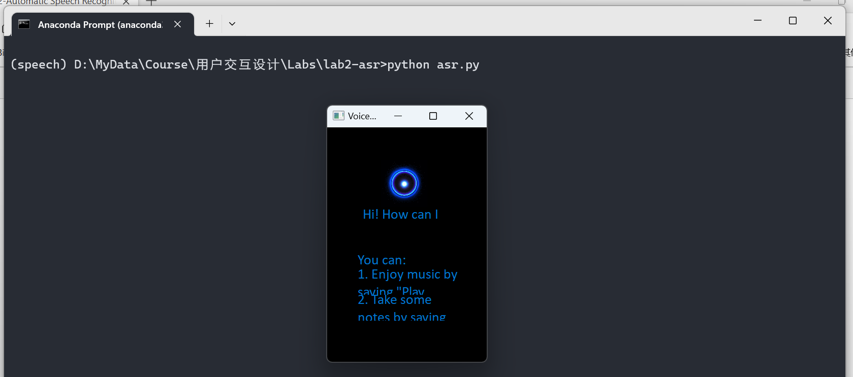
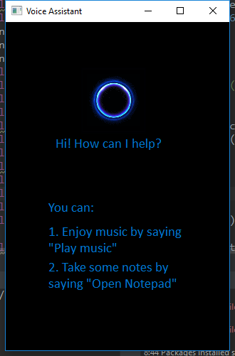
Run Example
运行程序：python asr.py

Slide 12
Interface of assignment1
Requirements:
The program could receive user’s voice command, recognize the content and finish the task
Assume commands are correctly spoken
Input:
A voice command from the user
Output:
Finish the task

Slide 13
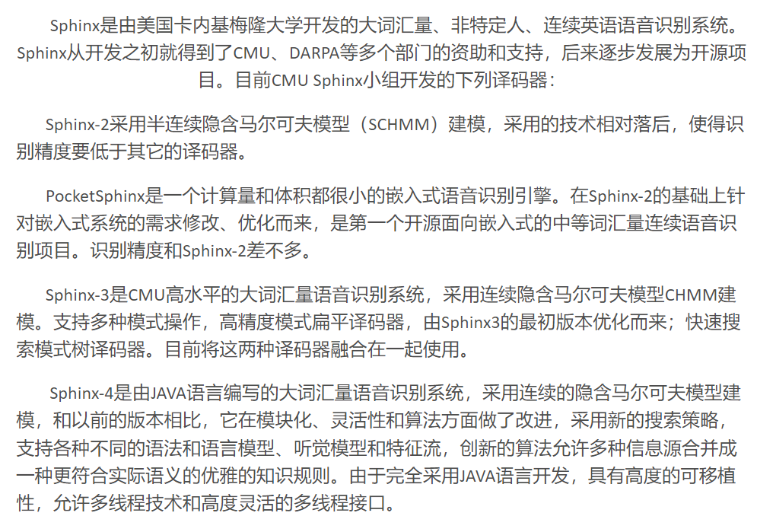
Install PocketSphinx (Linux)
In Terminal, run:
sudo apt-get install libpulse-dev
sudo apt-get install libasound2-dev
sudo apt install swig
sudo pip3 install pocketsphinx (“pip” for python2)

Slide 14
Install PyAudio (Linux)
In Terminal, input:
sudo apt-get install python-pyaudio python3-pyaudio

Slide 15
Install PyAudio (Mac OS X)
Use Homebrew to install the prerequisite portaudio library, then install PyAudio using pip:
brew install portaudio
pip install pyaudio
Notes:
If not already installed, download Homebrew.
pip will download the PyAudio source and build it for your version of Python.
Homebrew and building PyAudio also require installing the Command Line Tools for Xcode (more information).
Ref: http://people.csail.mit.edu/hubert/pyaudio/

Slide 16
Assignment
Run test.py and guessTheWord.py. Get familiar with the program.
Add two functions to the program (asr.py), such as
Play music
(tips: win32api.ShellExecute(0, 'open', 'E:\\song.wma', '','',1))
Open a text file
(tips: win32api.ShellExecute(0, 'open', 'notepad.exe', '','',0))
Any other function you’d like to implement
You can find many examples of how to call external commands in python on the web

Slide 17
Report
The report should answer the following questions:
The modifications to GUI and the codes
The accuracy of speech recognition and how to improve it, if possible?
Submit your work (code and report)
Prepare a readme file to illustrate how to run your program
Compress all the codes and the report into a zip file: ID_name_lab2.zip
Canvas上提交
4月21日前，迟交1天扣1分

